Slide 1




Good/Bad, Happy/Sad
conducting sentiment analysis on user survey data from Houghton Library with R

Slide 2
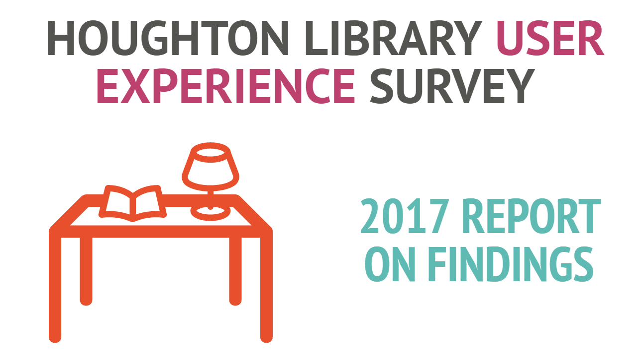

Slide 3
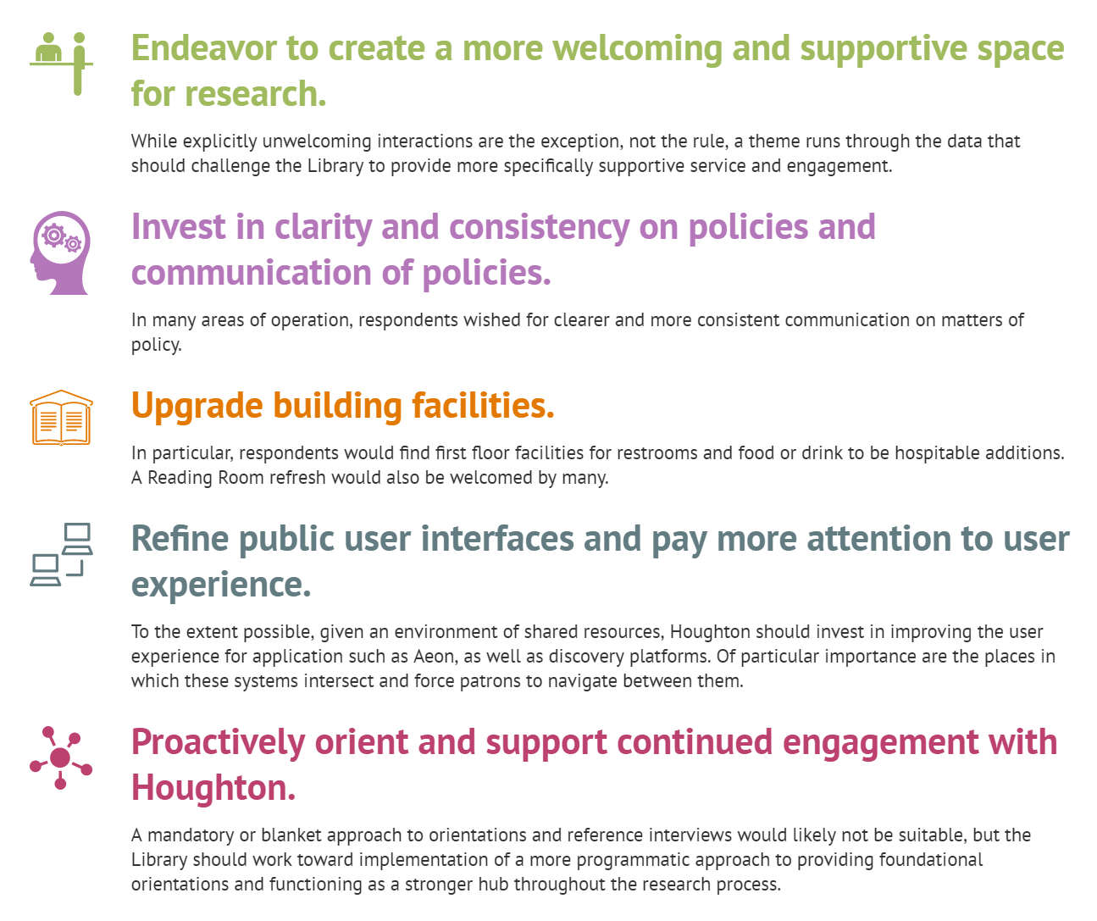

Slide 4
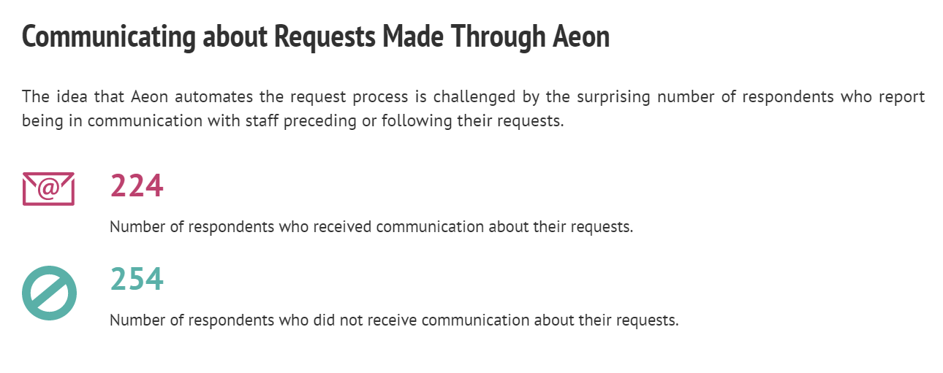

Slide 5
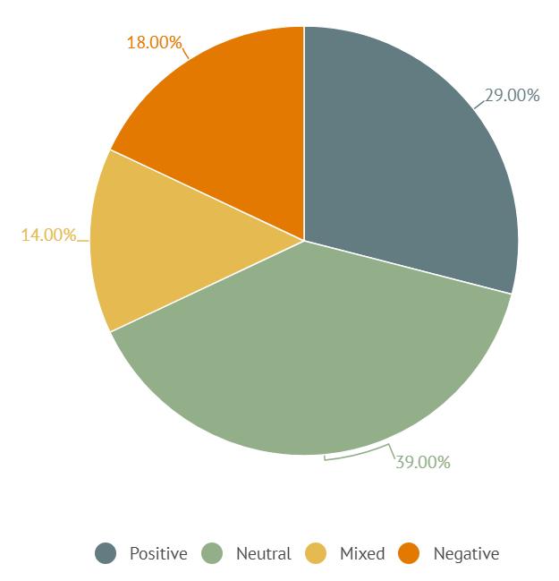
Comments on Staff
Communication
Concerning
Aeon Requests

Slide 6
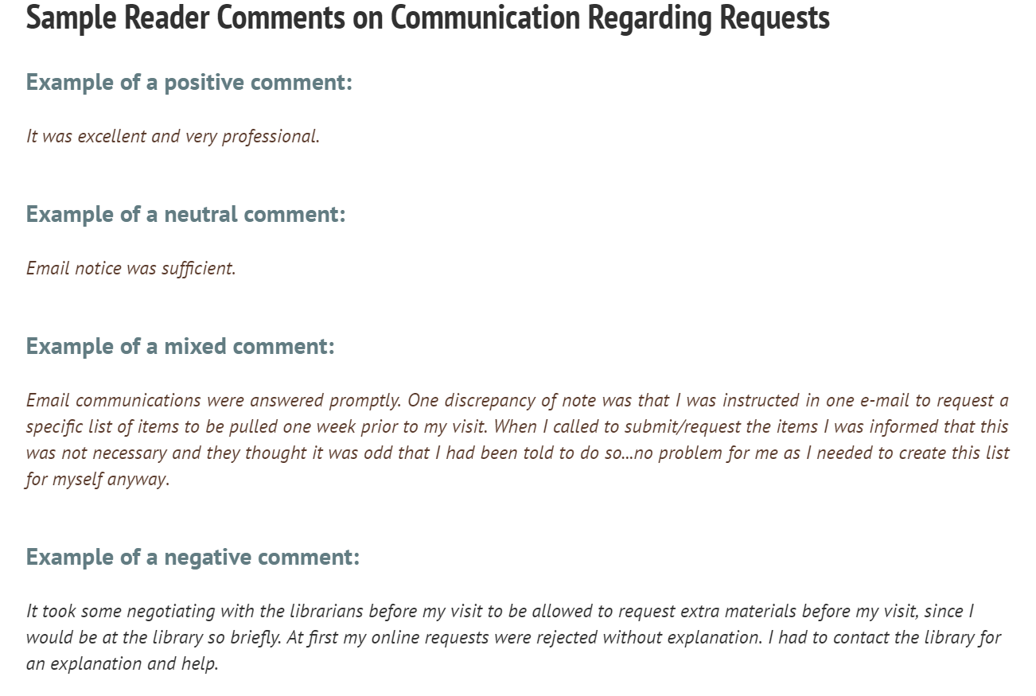

Slide 7
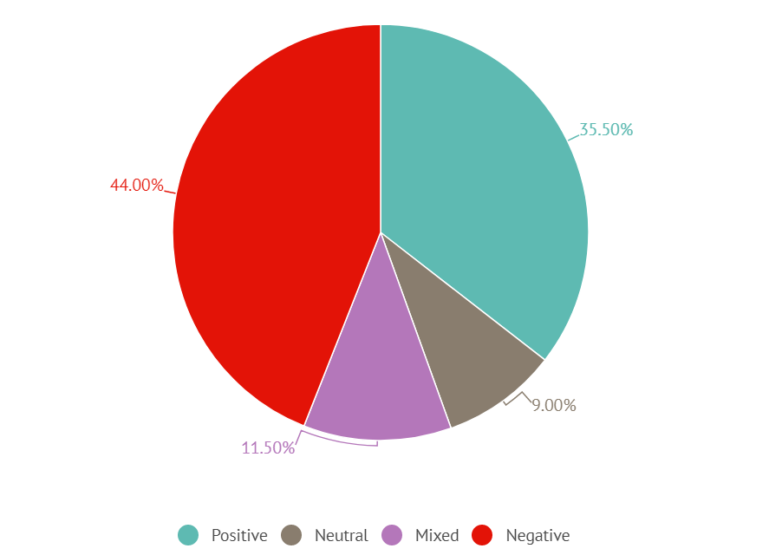
Coded Comments on Staff Implementation
of Security Measures

Slide 8
Comment / Q34 | Admin Code | Intercoder Check 1 | Intercoder Check 2 | Machine Code | Discrepancy Rate | Alignment
…. | Positive | Positive | Positive | Very Positive | 0 | n/a
…. | Neutral | Mixed | Neutral | Neutral | -1 | Primary
….. | Mixed | Negative | Negative | Mixed | -2 | Coders
….. | Negative | Negative | Negative | Negative | 0 | n/a

Slide 9
sen·ti·ment a·nal·y·sis
noun
the process of computationally identifying and categorizing opinions expressed in a piece of text, especially in order to determine whether the writer's attitude towards a particular topic, product, etc., is positive, negative, or neutral.

Slide 10
tools
Form data
(Jotform with Google sheets integration)
Refine
R
R-sentiment package

Slide 11




Calculate_sentiment: classifies your text into a sentiment category
Very Negative Positive
                Negative Very Positive
                Neutral Sarcasm

Slide 12

Thanks.
ehardman@fas.harvard.edu

